Slide 1
Department of Information Technology
Welcomes NBA Committee
5th February, 2019

Slide 2
Presentation on Department Overview for UG Programme
Department of Information Technology

Slide 3
Outline
PART-I: DEPARTMENT PROFILE
PART-II : STRENGTHS & WEAKNESSES OF THE DEPT. AS PER
LAST NBA REPORT
PART-III : NBA COMPLIANCE

Slide 4
Institute Vision:
Thakur College of Engineering and Technology will excel in Technical Education to become an internationally renowned premier Institute of Engineering and Technology.
Department Mission:
The IT Department is committed to enrich students by rigorously implementing quality education with a focus to make them industry ready, while imbibing in them professional ethics and social values to become responsible citizens.
Department Vision:
The Department of IT will strive to be at the top position among the renowned providers of IT education.
Institute Mission:
To provide state of the art infrastructure and right academic ambience for developing professional skills as well as an environment for growth of leadership and managerial skills to students which will make them competent engineers to deliver quality results in industry.

Slide 5
Program Highlights
2002
2003
UG (IT) intake increased to 120
2011
Started with UG (IT) with an intake of 60
2011
NBA accreditation (1st cycle) for 3 years
PG (IT) started with an intake of 18
2015
Permanent Affiliation by University of Mumbai
2016
NBA accreditation (2nd cycle) for 3 years
2017
Awarded ‘A’ Grade by NAAC for 5 years w.e.f. 30th October 2017
2018
Ph.D (Technology) IT started with an intake of 10

Slide 6
Program Highlights
Program offered & Intake
Success rate
85.71% ( A.Y 2014-18)
Placement, HOC & EDC
1000+ students since inception, 266 in last 3 yrs – in process
4 years B.E. (IT) - (120)
Prof. Body
ACM , 86 student members of current batch and counting
2 years M.E. (IT) - (18)
Ph.D. IT (10)
105 students opted for higher studies
21 Students as Entrepreneurs
Dept. Library
600+ including text books & reference books
UG project reports
700+ since inception
Publication
E-Zine Technical magazine released its 10th edition, vol.2
Curriculum enrichment
Programme resource book, Course resource book
NewLetter Sankalp

Slide 7
I. Department Profile
Information Technology
UG Course

Slide 8
Department Profile
Student
120 Intake +
24 DSE –(BE)
18 –(ME) 10- (Ph.D.)
SE, TE, BE, ME, Ph.D.
Faculty
Faculty Members:28
PG recognized:06
Professors:03, Assoc.Profs:03, Assistant Professors:22
Infrastructure
8 UG Labs
1 ME LAB
1 Ph.D. Lab
2 Faculty Room
4 Meeting Room
5 UG Classrooms
01 ME Classroom
1 Tutorial/Smart Class room
Departmental Library
5 Laboratory Assistants
3 Lab Attendants
Seminar Halls-3,
Multipurpose room,
Digital Library
Ph.D. :06, Ph.D(Pursuing):06, M.E/M.Tech:16
Approved Ph.D. guides: 02 (UOM)

Slide 9
Organogram

Slide 10
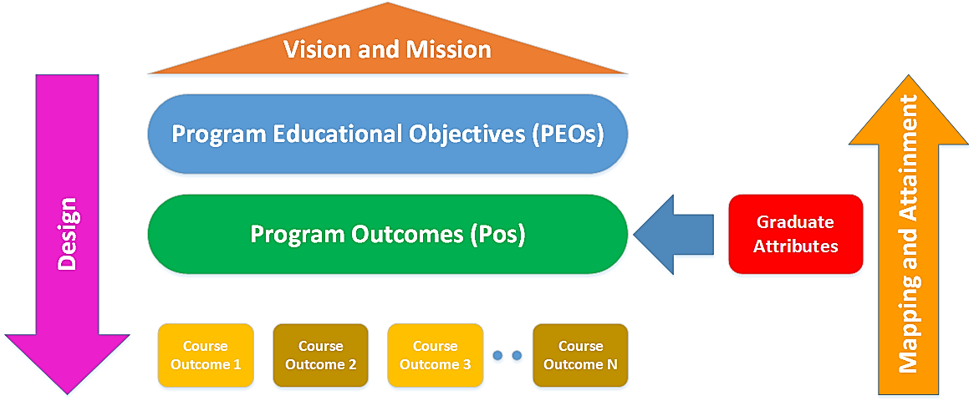
VMS, PEO, PO, GA and CO Relation
Mapping
Attainment
OBE is practiced to enhance Educational Productivity

Slide 11
Overall Growth Plan
Improvement
CO-PO Attainment with Direct, Indirect tools
Success rate
Value addition
Number of publications
Innovation
Advanced technology related Courses delivered at incubation center on Bitcoin, ML & Data science, DevOps, Linux etc.
ISRO Project Extension
Placement
Faculty involvement to deliver CDAC lectures
IAT Question paper setting through RBT
Center of Excellence – IoT, PCs procurement
Cadre Ratio
Industry Relevant Bridge Courses
Faculty Publications
Online certification – Faculty, students –NPTEL etc.
R&D Projects & IEDC Grants,
Teacher Guardian Case study – Fast, medium, slow learners
Cost effective TLP with audio-visual facility
Project based learning for SE,TE students
Number of books at department library
Faculty Awards
Video recording of lectures
Smart India Hackathon 2017 winners, 2018 zonal participation, 2019 winner of International Hackathon “Blockchain & IoT”
Conduct of Intl. Conferences - IEEE & Springer
RPS members - NIT Surat, JNTU-Anantpur & GTU-Gujarat
PSOs enforcement
ABL activities
Students Internships
Industry interaction from experts for conduct of technical seminars, workshops
Financial power to HODs, 20,000/- per month
Use of ERP-LMS system
Use of ICT-Flipped, Google classroom, Role based activity, Wordpress – created webpages for students shared through youtube channel
Faculty contribution in UoM syllabus revision etc.
Patents filed
Industry connects – Lab. solutions, Zyphility, Ronak Incaps
AICTE 3i survey from being ranked high to platinum category
Consultancies
Industrial Collaborations
R & D Budget
Ph.D. –IT Research center
Industry Institute linkages through CII
Smart Classroom
Reviewer of Transaction, Inderscience Journals
Video recording consultancy for r-vision
Content development for Star certification- US on DevOps
Design based assignment
Students with 10 Pointers

Slide 12
Salient Features (2016-19)
Academic:
Average Success rate of 77.7% of 14 batches
Strong cadre ratio and faculty retention
3 toppers and 1 university rank holder
Video recording of lectures
Ph.D. Research center
Programme Resource Book Preparation to enrich curriculum
Question Paper setting through Blooms Taxonomy
Strong Advisory committee, Regular PAC review
Student Validation, Exit, Course Survey, PO-PEO achievement
Permanently Affiliated to University of Mumbai
Faculty achievements
BoS chairman, Academic Council Member and RRC Member, RPS member at NIT Surat, JNTU Anantpur, GTU Ahmedabad,
Ranked high in 3i survey conducted by AICTE-CII in AY 2013-2014, currently with platinum category
Conducted conferences with affiliation of ACM, Elseiver, IEEE & Springer
Twice Accredited by NBA for 3 years & Accredited by NAAC with A grade
3 awards received by faculty members
Smart India Hackathon 2017 winners (ISRO,MHRD), 2 teams been at zonal level in 2018, 2019 winners of International Hackathon on “Blockchain & IoT”
Consultancy:
4 Patents filed, 6 Consultancies, 5 industry collaboration projects, 2 interdisciplinary project, 6 training conducted, 2 Copy rights & Publications, ISRO project extension received
Joint Research with other organizations, BARC
2 Centre of Excellence (IoT-Intel & TAIC), 2 in process Research grants from AICTE,IEDC, Microsoft , Accenture and University of Mumbai.
Industry relevant technology courses offered at incubation center on advanced courses viz. Bitcoin, ML & Data science, DevOps, Linux, Cloud computing & Open source Technology
Student participation / achievements
Placement of 1000+ (266+ last 3 yrs) students since first batch, 105 students opted for higher studies, 2 students started their startup (EDC) includes 21 Entrepreneurs.
Automation of Teacher Guardian –Student Mentoring Scheme, Project out-reach to society (TVM)
HOC cell – CDAC, NPTEL Courses, Oracle , FOSS Certification delivered by faculties, 20% students opting for higher education
Conducted International Hackathon on “Blockchain & IoT” won by students & faculty members

Slide 13
Domains at Department

Slide 14
II. STRENGTHS & WEAKNESS - LAST NBA REPORT (STRENGTHS)

Slide 15
Strengths and weakness of last NBA committee visit report -2016 & its mitigation criteria wise till date
Strengths and weakness of last NBA committee visit report -2016 &
its enrichment / mitigation criteria wise till date
Criteria No. | Strength reported by NBA committee (Y-Compliance) | Strengths enrichment since 2016
1 | Vision , Mission formulation | Formulation, Percolation & dissemination of VMS- class, website, journals , dept., etc., achievement through linkage with PEOs
2 | Documented process in place to measure the attainment of defined POs. Defined COs must contribute attainment of COs. Curricular delivery and assessment methods are amended based on attainment of POs. Each PO must significantly achieve at least one of the PEOs | Attainment of POs is calculated for batch wise both with & without H,M,L 6 COs defined & maintained for uniformity across 6 modules in all courses Curricular delivery assessment is carried out indicating PEOs achievement, calculation done based on at least 1 PO for all the last 3 batches (2012-16, 2013-17 & 2104-18).
3 | Structured curriculum addressing program specific criteria (PSC) b) Components of curriculum, Outcomes of core engg.to acquire professional competence, skills. Process justified for improvement in courses, content delivery & assessment methods | a) Structured curriculum is addressed for PSC is mapped w.r.t international syllabus, along with reference of national statutory/ regulatory bodies (AICTE,UOM) b) Direct (IAT, Practicals, SEE & SV), indirect tools (Course/Exit survey)

Slide 16
Strengths and weakness of last NBA committee visit report -2016 & its mitigation criteria wise till date
Strengths and weakness of last NBA committee visit report -2016 &
its enrichment / mitigation criteria wise till date
Criteria No. | Strength reported by NBA committee (Y-Compliance) | Strengths enrichment since 2016
4 | Success rate, Academic performance , Placement , higher studies, innovation initiatives etc. must be consistent with attained POs & PEOs | Consistent performance in success rate, academic performance, placement, higher studies, initiatives etc., is clearly indicated for attainment of POs, PEOs
7 | Academic support units – engg. labs, language lab., to fulfill the prerequisite of core & optional engg. Courses | All required tools, licensed software, open source are available to conduct all courses at dept.
8 | Campus infrastructure, library, internet, counseling & emergency facilities must satisfy requirements of the programme | Campus Infrastructure (Intel IOT CoE, TAIC, Upgradation of labs), library books, internet , counseling & emergency facilities satisfy the requirements at dept. level as required

Slide 17
II. STRENGTHS & WEAKNESS - LAST NBA REPORT (WEAKNESs)

Slide 18
Criteria 1: Concern 1- Lack visibility in terms of support – Administrative system in attaining PEOs
Year:2016-17
Brochure
Semester orientation program
Advisory, PAC, Parent meeting
Website
Year:2017-18
Classrooms display
Student lab. Journals
Faculty Diary
Year:2018-19
Faculty Diary
Website
Students expt. write-ups
Technical magazine (E-zine)
Mission Keywords – Attainment
Enrich students: SOP, PBL, Hackathon, R&D activities
Quality education: Curriculum delivery, Lab journals, OBE based
assignments and expt.
Industry ready: Technical seminars, ICC, Preplacement training,
Professional ethics: conference publications
Responsible citizen: participation in NSS
The objective of above processes is to achieve PEOs effectively & align department VMS with institute VMS

Slide 19
PEOs – Implementation
Best Practices, Information Security, Integrity, Professional Compliance
PEO 6
Deals
with
Campus Connect, Professional Body, Bridge courses & Co and Extra curricular
activities
Achieved by
Attained through
PEO 7
Communication skills for professional growth
, Teamwork, Professional Growth, Successful Career
Deals
with
VISSION
MISSION
Implemented
through
Higher Education and Online Certification Cell (HOC)
Achieved by
Higher Studies, successful career in Indian and Multinational Organizations
PEO 3
Deals
with
Attained through
PO

Slide 20
Establish consistency of PEOs with Mission of the Department
Establishing the consistency of the PEOs with the mission of the department was not there in earlier SAR
In the current SAR, consistency of the PEOs with the mission of the department is established as follows:
Keywords of the Department Mission
Keywords of the Department mapped to the PEOs
Department Keywords
KWMD 1: Enrich Student
KWMD 2: Quality Education
KWMD 3: Industry Ready
KWMD 4: Professional Ethics
KWMD 5: Responsible Citizens
PEO Statements | KWMD1 | KWMD2 | KWMD3 | KWMD4 | KWMD5 | KWMD6 | KWMD7
PEO1: | 3 | 1 | 3 | 2 | 3 | 1 | 2
PEO2: | 3 | 2 | 3 | 3 | 3 | 2 | 3
PEO3: | 2 | 3 | 2 | 2 | 1 | 3 | 2
Note: KWMD1, KWMD2,... KWMDn are distinct keywords of Mission statement.
Correlation levels 1, 2 or 3 are defined below:
1: Slight (Low) 2: Moderate (Medium) 3: Substantial (High

Slide 21
Criteria 1:Concern 2 CO-PO attainment process is not clear
Year:2016-17
Direct tool: SEE, IAT
Indirect tool: Course survey, Exit survey
Year:2017-18
Direct tool: SEE, IAT, Practical's, Assignments
Indirect tool: Course survey, Exit survey, Co/Extra curricular activities
Year:2018-19
Direct tool: SEE, IAT, Practical's, Assignments
Indirect tool: Course survey, Exit survey, Co/Extra curricular activities
GA’s 7 to 12 are enriched & attained through various Co-Extra curricular activities (ABL,PBL etc.)

Slide 22
Criteria 1: Concern 3
CR 1: Documentary evidence for periodic review is not sufficient towards calculation of attainment.
Periodic review is checked for Calculation of PO attainment, PEO achievement semester wise & batch wise

Slide 23
PEOs Revision
2001
Establishment of Institute with the PEO (Quality Objectives) of creating competent engineering Graduates
2005
ISO: 9001:2000
implemented with PEO of Quality Engineering Graduates. PEOs set through Quality Objectives
2009
ISO: 9001:2008 (Emphasis on design & development)
5 PEOs defined as per NBA SAR.
2013
ISO: 9001:2008
Formalization of PEOs (reference from PEOs of UoM, NBA Graduate Attributes) & alignment with quality objectives. And based on stakeholders feedback.
2017 – Design & Development of Co/extra curricular with stakeholders inputs (ref:ISO)
In 2018, 7 PEOs are changed to 3 PEOs – Advisory, PAC meeting

Slide 24
Revised PEOs
Previous PEO’s (2017-2020) | Updated PEO’s (W.e.f.2018-19)
PEO 1: To enable learners to gain a broad background across fundamental areas of information technology along with a depth of understanding in a particular area of interest within the domain of information systems. | PEO 1: To prepare learners with a strong foundation in the area of information technology required to solve real life problems arising through software technology. (Foundation)
PEO 2: To prepare learners to use effectively modern programming tools to solve real life problems.
PEO 3: To prepare learners for successful career in Indian and Multinational Organizations, Identify and evaluate current and emerging technologies. To assess their applicability to address the users’ needs and recognize the need for continued learning. To motivate students to pursue it throughout their career and higher studies. | PEO 2: To prepare learners to be knowledgeable of the ethics, professionalism and cultural diversity in the work environment to meet applicable standards with continued motivation for research and development. (Professionalism, Quality and R&D)
PEO 4: To encourage and motivate learners for Research & Development and entrepreneurship.
PEO 5: To inculcate independent, critical thinking, problem solving and leadership skills, with an ability to analyze the impact of technology on individuals, organizations and society including professional, ethical, legal and public policy issues. | PEO 3: To prepare learners to understand the need for lifelong learning with effective written and oral communication skills and to be able to readily adapt to new software engineering environments. (Presentation and Growth)
PEO 6: To encourage learners to use best practices and implement technologies to enhance information security and enable compliance, ensuring confidentiality, information integrity, and availability.
PEO 7: To develop excellent written and oral communication skills to effectively interact with clients, users, co-workers and managers. To Collaborate and work in teams to accomplish a common goal by integrating personal initiative and group cooperation.

Slide 25
Programme Outcomes (Graduate Attributes - GAs) &
Programme Specific Outcomes (PSOs)
PO’s (GAs) | PSO’s | Statements
PO 1: Engineering Knowledge PO 2: Problem Analysis PO 3 : Design / Development of Solutions PO 4 : Conduct Investigations of Complex Problems PO 5: Modern Tool Usage PO 6 : The Engineer & Society PO7 : Environment & Sustainability PO8 : Ethics PO9 : Individual & Team work PO10: Communication PO11: Life-long Learning PO12: Project Management | PSO 1 PSO 2 PSO 3 | To develop the culture of augmenting existing technologies to create scalable IT solutions To combine various technologies like IoT, Cloud and Analytics to provide integrated solutions to real time problems of government /industries. To master in moulding any problem into a web/internet based solutions.

Slide 26
Revision of PSOs & PEOs
As per discussed in advisory meeting on dated 02/11/2017,Inputs are taken from stake holders for revision of PSO . The PSOs are revised form 7 to 3.
Revised PEOs from 7 to 3, implemented in 02/11/2018 in PAC committee
GAs are equivalent to POs

Slide 27
Criteria 2 :Concern 1 Improvements in GAs:7-12
2015-16
NSS
EWT
Technical Paper presentation during Zephyr (tech fest)
Conferences
2016-17
NSS
EWT
Projects: (Agriculture,
Healthcare, EVS)
2017 – 2018
ABL activities - Domain, Professional body & Remedial
Green IT
Projects: Mini, Minor
Major
SIH-Hackathon activities
GA7- Environment & Sustainability,
GA8 - Ethics,
GA9- Individual & Team work,
GA10-Communication , GA11- Life-Long learning ,
GA12- Project management & Finance

Slide 28
Criteria 2:Concern 2
CR 2: a) Tools to measure attainment of POs need proper understanding and applications
b)Inadequate documentation of process for periodic reviewing and revision of the POs
a)Direct tools - Includes Internal assessment test, Semester end exam, Practicals, Assignments
Indirect tools – Course Survey & Exit Survey.
b) Periodic review is checked for Calculation of PO attainment, PEO achievement semester wise & batch wise

Slide 29
Form
Course Survey
Case Study
Exit Survey
 | PO-1 | PO-2 | PO-3 | PO-4 | PO-5 | PO-6 | PO-7 | PO-8 | PO-9 | PO-10 | PO-11 | PO-12 | PSO1 | PSO2 | PSO3
ACADEMIC AVG ATTAINMENT | 2.27 | 2.30 | 2.27 | 2.25 | 2.22 | 2.01 | 2.11 | 1.94 | 2.31 | 2.03 | 1.99 | 2.21 | 2.67 | 2.64 | 2.62
EXIT SURVEY | 2.81 | 2.88 | 2.77 | 2.82 | 2.75 | 2.79 | 2.73 | 2.82 | 2.82 | 2.79 | 2.75 | 2.73 | 2.69 | 2.63 | 2.65
EXTRA AND CO CURRICULAR |  |  |  |  | 3.00 | 2.32 |  | 2.25 | 2.25 | 2.22 | 1.99 | 1.98 | 2.66 |  | 1.76
FINAL PO ATTAINMENT | 2.38 | 2.41 | 2.37 | 2.36 | 2.35 | 2.12 | 2.23 | 2.06 | 2.36 | 2.12 | 2.07 | 2.24 | 2.67 | 2.64 | 2.53

Slide 30
PEO achievement batch wise 2013-17 & 2014-18
60% threshold is considered on scale of 3, thereby 1.8 as threshold is taken for balancing of PEOs

Slide 31
Criteria 3 – Concern 1 Limited Participation of Industry
Year : 2015-16
Seminars
Workshops
Internships
Local & outstation industrial visits
Year : 2016-17
Seminars
Workshops
Industry Bridge Courses
Internships
Local & outstation industrial visits
Year : 2017 - 18
Seminars
Workshops
Industry Bridge Courses
SME connect for domain development, student internships (both internal & external)
Local & outstation industrial visits

Slide 32
Industry Interaction
Year | Technical Seminars | Bridge courses | Workshops | Debate competition | Mini Project Competition | Quiz competition | Industrial Visits
2018-19(Odd) | 4 | 3* | 1 |  | 1 | -- | 2
2017-18(Odd) | 4 | 3* | 1 | 1 | -- | 1 | --
2017-18(Even) | 4 | 3* | 1 | 1 | -- | 1 | 1
2016-17(Odd) | 3 | 3 | 1 | -- | -- | -- | --
2016-17(Even) | 2+3 | 2 | 1 | -- | 1 | -- | 2
2015-16(Odd) | 1+3 | 2 | 1 | -- | 1 | -- | --
2015-16(Even) | 1+3 | 2 | 1 |  | 1 | -- | 1
Total | 28 | 18 | 7 | 2 | 4 | 2 | 5

Slide 33
Student participation in Co/extra curricular Activities during last three batches
No. of Students

Slide 34
Students - Internship Details of last 3 years
No. of Students
Academic Year
* - In process

Slide 35
CR:5-Concern 1 Faculty qualification & cadre ratio needs improvement
Year:2016-17
Professor:02
Associate Prof:04
Assistant Prof: 20
Ph.D.: 3
Year:2017-18
Professor:03
Associate Prof:03
Assistant Prof: 24
Ph.D.: 5
Year:2018-19
Professor:03
Associate Prof: 03
Assistant Prof: 22
Ph.D.: 6
One Faculty Submitted Thesis

Slide 36
Faculty Qualification during last 3 years
No. of Faculties
Academic Year

Slide 37
Criteria :5 Concern 2 Quality of publication needs improvement- minimal ongoing funded R&D project, No consultancy work, Poor interaction with outside world (Sponsored Research/Consultancy)
Sponsored Research/Consultancy
Total amount : Rs.28,22,400/- (Funded research - 6,43,000/- & industrial Consultancy of Rs.20,00,000/-)
Grants Received From
AY | IEDC | MRG | Industrial Consultancy | Total Sanctioned Amount | Actual Received Amount
2018-19 | 1,00,000/- |  | 8,50,000/- | 9,50,000/- | 3,00,000/-
2017-18 | 1,0,0000/- | 90,000/- | 11,50,000/- | 13,40,000/- | 5,75000/-
2016-17 | 2,00,000/- | 1,53,000/- | 1,79,400/- | 5,32,400/- | 5,32,400/-
2015-16
Total | 4,00,000/- | 2,43,000/- | 20,00,000/- | 28,22,400/- | 14,07,400/-

Slide 38
Publication Details(AY:2015-19)
No. of Publications
Total no. of publications since inception till AY 2015-16: 233 , Total no. of publications till date :479, Difference :246

Slide 39
Faculty publications citations till date
Name of the faculty member | h-index | i10-index | No. of citations
Dr. Deven Shah | 7 | 2 | 122
Dr. Kamal Shah | 5 | 4 | 126
Dr. Rajesh Bansode | 4 | 2 | 80
Mr. Vikas Kaul | 6 | 2 | 66
Dr. Zahir Aalam M.M. | 2 | 0 | 18
Dr. Bijith Marakarkandy | 5 | 4 | 83
Mr. Namdeo B. Badhe | 1 | 0 | 3
Mrs. Vandana Munde | 1 | 1 | 3
Mrs. Pranjali Kasture | 1 | 0 | 8
Dr. Sangeeta Vhatkar | 5 | 3 | 71
Mr. Anil K. Vasoya | 2 | 0 | 9
Mr. Bhushan Nemade | 7 | 4 | 85
Mr. Vijaykumar Yele | 0 | 0 | 0
Mr. Aaditya A. Desai | 5 | 2 | 62
Mrs. Hetal Amrutia | 1 | 0 | 3
Mrs. Purvi Sankhe | 2 | 0 | 6
Ms. Neha Kapadia | 1 | 1 | 3
Mr. Rahul Neve | 1 | 0 | 5
Mr. Shridhar Kamble | 2 | 0 | 13
Mrs. Mary Margarat | 2 | 0 | 7
Mr. Sudhir Dhekane | 1 | 0 | 1
Mrs. Neha Patwari | 1 | 1 | 3
Mrs.Shruti Mathur | 4 | 2 | 116
Mr.Sandip Bankar | 1 | 1 | 3
Ms.Nishta Mathur | 1 | 1 | 15
Ms.Swati Abhang | 1 | 1 | 3
Average | 2.65 | 1.19 | 35.15
Source: Google scholar citations

Slide 40
Criteria 7:Concern 1 - Needs improvement in self-learning, tutorials & faculty qualification for first year
Year:2016-17
Faculty assigned for SPA subject for First Year
MOOCs
Year:2017-18
Self learning- NPTEL
Collaborative learning-student Internships
NPTEL
Coursera
Year:2018-19
Self Learning- Classroom mode, NPTEL,MOOCs, Coursera etc.
Tutorial room
Design based assignments-OBE
Student internships – in-house & external

Slide 41
Criteria 8: Conern1,2 – Governance, Institutional support & Financial Resources
Criteria 8: a)Highly inadequate R&D budget
b)Very little decentralization of financial power
a)R&D budget is now increased to 5Lacs per year/ dept. to
carry on research activities, domain wise etc.
b)Financial power is decentralized & Rs.20,000/- (monthly,
as petty cash) is given to HODs for regular use during
workshops, seminars, STTPs etc.

Slide 42
Details of R&D Budget
R & D Budget
Sr.No | Budget Head
1 | Components for IOT Lab
2 | BE Project Hardware
3 | Raspberry Pi B
4 | Technical Seminar
5 | Technical Workshop
6 | Industrial Visit
7 | Project Competition
10 | Domain Wise Activity
11 | Institute Level Activity
12 | FDP
13 | Hackathon
14 | Organizing Conference at international Level
15 | Registration fees for skill enhancement course, MOOCs ,STTPs etc.
16 | Promotion and Research Consultancy Activity
17 | Resource creation
18 | Holistic student development
19 | Inhouse internship
8 | Publication/Participation in Conferences
9 | Professional Student Development

Slide 43
Criteria 9: Concern1,2 Continuous Improvement
Criteria No. | Weaknesses reported by NBA committee (C -Concern) | Weaknesses Mitigated since 2016
9 | a)Some of these metrics like FRP,FQI, and faculty cadre ratio needs improvement b)No Significant new facilities added for program since last accreditation. Partial compliance observed | a) FRP,FQI with cadre ratio improvement can be observed for last 3 yrs b)New facilities included viz. smart classroom, Intel IoT Center of excellence, upgradation of PCs for labs., Cost effective TLP for audio-visual facility in classrooms, ERP implementation for effective TLP activities for enrichment since last accreditation etc. Dedicated tutorial room (403)

Slide 44
Financial assistance to students at institute level
A.Y | No of Students | Individual student Amount in Rupees | Name of Students | Total Amount in Rupees
2016-17 | 1 | 1,26,176 | Bharat Paliwal | 1,26,176
2017-18 | 3 | 1,33,846 | Bharat Paliwal | 3,11,842
 |  | 50,000 | Chitronda Vrundali
 |  | 1,27,636 | Shruti Agarwal
2018-19 | 1 | 50,000 | kanishk Trivedi | 50,000
Total Amount in Rupees
Total amount of Rupees 4,88,018/-
Not Covered under any Other Government Scheme

Slide 45
IMPROVEMENTS in Curricular, Co/Extra curricular, Beyond Curriculum , Industry Connect

Slide 46
Curricular Growth
POs attained: 1,2,3,4,5,6,11,12
2106-17
Lecture effectiveness through formal, Informal feedback
Project conduct based on societal applications on major categories domain wise (R,C,I,A)
Self-learning - peer learning for end exams, projects, MOOCs etc.
Remedial work for defaulters compensate academic loss, Open book test
Assignments based on OBE based, Design based expt., surprise test OBE based expt. Write-ups , Practical planning
Use of ICT- Moodle for classroom usage
2107-18
Video recording of lectures to bring effectiveness in lecture delivery
Feedback of lab.,/project conduct –waterfall model, Design methodology to emulate real life situations
Self-learning, IAT Question paper setting using Revised BT, NPTEL etc.
Collaborative learning – preparation of competitive exams etc.
Assignments –online, use of wordpress for sharing resources with students
Flipped classrooms Use of ICT
2018-19
Video lectures recorded are returned to faculty members to check for improvement in lecture delivery
Feedback of lab.,/project conduct, waterfall – research, Agile method-incremental way for application based projects
Self-learning for learning online courses through Coursera, MOOCs etc.
Collaborative learning –Blended learning (Technology based, project based, activity based
Design based assignments based on revised BT, OBE based
Use of Flipped, Google classroom – use of ICT, role based teaching activity, created webpages on you tube channel for students support

Slide 47
Co-curricular Activities (Including PBL)
2016-17
Technical seminars, technical quiz, Industry oriented campus connect programmes
R&D workshops, Hobby club, Consultancy at BVH for Google Apps
Industrial Visit –Local, out station, Doubt solving practice, Extra lectures on working Saturdays. Technical Magazine (E-Zine) with stakeholders involvement
Professional body activities – technical workshops, seminars, Pre-placement training, Corporate training for TE students etc.
2107-18
IEDC grants, external internship
R&D workshops, OCPJP, NPTEL Certifications ,Workshop on PC assembly, Seminar on IT strategy
Mini & minor projects domain wise, NEN workshop, Idea presentation
Professional body activities – technical workshops, seminars etc.
2018-19
Internal in-house internship
R&D workshops Industrial Visit –Local, out station
Professional body activities – technical workshops, seminars etc.
Professional body activities – industry relevant technical workshops, seminars etc.
POs attained: 1,2,3,4,5,6,10,12

Slide 48
Extra curricular Activities (Including ABL)
2016-17
Advisory meeting, Ethics & value education activities etc.
PBL projects, Poster making Portfolio building, Hackathon competition-winners.
Domain activities, CR meeting with principal
Health awareness seminar
Technical paper presentation (Zephyr)
Parents meet
2107-18
Mind mapping & Yoga practice sessions
Hackathon competition, Debate competition
R&D activities
Ethics & value education activities etc. Rotract club- Helmet awareness drive
Industry linkages programmes Career options after engg. Behavioral economics
NSS,EWT, Parents meet
2018-19
Advanced yoga practice sessions, Hostel meet
Quiz competition International Hackathon event-winners
Group Discussion
Rotract club – poster making
Awareness about competitive exams,,
E-waste awareness Solar Technology
seminar on Education Technology
Parents meet
POs attained: 6,7,8,9,11 & 12

Slide 49
Beyond Curriculum (Including TBL Activities)
POs attained: 1,2,3,4,5,7,9,10, 11,12
2016-17
Mini projects
Technical paper writing among students at TE,BE level during SOP
Bridge courses delivered for 20 hrs to bridge technicality for industry level courses
Teacher Guardian Counseling for academic improvement- Holistic development
Students technical paper submissions at conferences, Students online certification carried out through MOOCs
2107-18
Mini, minor along with Design based expt, Feedbacks & surveys, IoT Projects at GEV
Technical paper writing among students at TE,BE level for the miniprojects and major projects carried out
Bridge courses delivered for 20 hrs to enhance learning of programming languages, inputs form industry experts – advisory meetings, technical seminars
Teacher Guardian Counseling for academic improvement- Holistic development, Slow, medium & fast learners, Software developed
Students technical paper submissions at multicon-w conference, Online certifications-MOOCs, NPTEL
2018-19
Mini projects in curriculum courses –electives
Technical paper writing among students at SE,TE with PBL
Bridge courses delivered for 20 hrs to bridge technicality for industry level courses
Teacher Guardian Counseling for academic improvement- Holistic development
SDAC exams for students placement, Students technical paper submissions at conferences, Online certifications- MOOCs, NPTEL, Couresa etc.

Slide 50
Industry Connects – to enhance collaborative learning
POs attained: 1,2,3,4,5,7,9,10, 11,12
2016-17
Bhaktivedanta Hospital- Google Apps Consultancy
2107-18
Bhaktivedanta Hospital- Internship for TE students
2018-19
Bhaktivedanta Hospital-Internship for SE students
Ronak InCaps – Internship for TE students on Augnmented & Virtual reality
Lab Solutions - Digital forensic – Forensic of BitCoin transaction.
Create prototype of evidence mgmt. using Blockchain
Zyphility - Identify & develop product for KYC on Blockchain.
Portability on Blockchain
Science kidz lab technology industry Internship for TE students

Slide 51
III. NBA COMPLIANCE

Slide 52
Faculty Details with SFR
SFR : 18 (AY 2018-19), No. of faculties -26
SFR:15.6 (AY 2017-18), No. of faculties - 30
SFR:16.71 (AY 2016-17), No. of faculties -28, Avg. SFR – 16.77
Cadre Ratio 1:2:6 – AICTE sources,
No. of faculties needed = 2:5:13 (UG+PG)
Dept. status - Professor : Asso. Prof.: Asst.Prof=3:3:20
No. of faculty members
Faculty Details
Faculty Details1

Slide 53
Faculty as participants in Faculty development/ training activities/STTPs
Faculty development/training activities/STTPs, FDP DATA

Slide 54
Research and Development (Academic Research)
Details of research

Slide 55
Publication Details(AY:2015-19)
No. of Publications
Total no. of publications since inception till AY 2015-16: 233 , Total no. of publications till date :479, Difference :246

Slide 56
CR:5 - concern-2 Quality of publication needs improvement- minimal ongoing funded R&D project , No consultancy work, Poor interaction with outside world (Sponsored Research/Consultancy)
Sponsored Research/Consultancy
Total amount : Rs.28,22,400/- (Funded research - 6,43,000/- & industrial Consultancy of Rs.20,00,000/-)
Grants Received From
AY | IEDC | MRG | Industrial Consultancy | Total Sanctioned Amount | Actual Received Amount
2018-19 | 1,00,000/- |  | 8,50,000/- | 9,50,000/- | 3,00,000/-
2017-18 | 1,0,0000/- | 90,000/- | 11,50,000/- | 13,40,000/- | 5,75000/-
2016-17 | 2,00,000/- | 1,53,000/- | 1,79,400/- | 5,32,400/- | 5,32,400/-
2015-16
Total | 4,00,000/- | 2,43,000/- | 20,00,000/- | 28,22,400/- | 14,07,400/-

Slide 57
Placement, Higher Studies and Entrepreneurship
Item | CAYm1 (2017-18) | CAYm2 (2016-17) | CAYm3 (2015-16)
Total No. of Final Year Students (N) | 154 | 154 | 160
No. of students placed in companies or Government Sector (X) | 89 | 101 | 79
No. of students admitted to higher studies with valid qualifying scores (GATE or equivalent State or National Level Tests, GRE, GMAT etc.) (Y) | 53 | 29 | 35
No. of students turned entrepreneur in engineering / technology (Z) | 0 | 0 | 1
X + Y + Z = | 142 | 130 | 115
Placement Index: (X + Y + Z)/N | P1=0.92 | P2=0.84 | P3=0.72
Average placement= (P1 + P2 + P3)/3 | 0.83

Slide 58
Placement, Higher Studies and Entrepreneurship
Placement

Slide 59
Placement, Higher Studies and Entrepreneurship
Higher Studies
Comparative Higher Studies

Slide 60
Comparative Higher Studies Examination Score Data

Slide 61
Internship_1
Internship
Student Competitive Exam

Slide 62
CDAC- courses
PG-DAC

Slide 63
STUDENTS : SUCCESS RATE,PROGRESSION, DETAILS & MENTORING

Slide 64
Success Rate of Last Three Batches
No of Students
Academic Year

Slide 65
Progress of Batch 2012-2016
Student Result Progression
End Semester Exam
Exam | Semester | Passing %
Dec 13 | III | 55.06 (72.15, Excluding AM-III)
May 14 | IV | 72.15
Dec 14 | V | 87.27
May 15 | VI | 95.65
Dec 15 | VII | 97.33
May 16 | VIII | 97.32
Term Test
Exam | Sem. | Term Test 1 | Term Test 2 | Avg.
Dec 13 | III | 98 | 82 | 90
May 14 | IV | 69 | 87 | 78
Dec 14 | V | 93 | 95 | 94
May 15 | VI | 99 | 99 | 99
Dec 15 | VII | 94 | 95 | 95
May 16 | VIII | 97 | 99 | 98

Slide 66
Progress of Batch 2013-2017
Student Result Progression
End Semester Exam
Exam | Semester | Passing %
Dec 2014 | III | 51.25 (72.63,Excluding AM-III)
May 2015 | IV | 81.53
Dec 2015 | V | 93.71
May 2016 | VI | 97.35
Dec 2016 | VII | 94.08
May 2017 | VIII | 93.42
Term Test
Term Test Analysis
Exam | Sem. | Term Test 1 | Term Test 2 | Avg.
Dec 14 | III | 90.24 | 90.63 | 90.435
May 15 | IV | 86.54 | 90.38 | 88.46
Dec 15 | V | 81.99 | 93.21 | 87.6
May 16 | VI | 94.27 | 96.23 | 95.25
Dec 16 | VII | 100 | 100 | 100
May 17 | VIII | 98.68 | 100 | 99.34

Slide 67
Student Result Progression
Progress of Batch 2014-2018
End Semester Exam
Exam | Semester | Passing %
15-Dec | III | 71.43
16-May | IV | 88.89
16-Dec | V | 94.94
17-May | VI | 97.44
17-Dec | VII | 99.35
18-May | VIII | 99.35
Term Test
Exam | Sem. | Term Test 1 | Term Test 2 | Avg.
15-Dec | III | 84.97 | 84.31 | 84.64
16-May | IV | 85.43 | 92.16 | 88.79
16-Dec | V | 95.6 | 96.88 | 96.24
17-May | VI | 96.77 | 92.75 | 94.76
17-Dec | VII | 96.13 | 98.7 | 97.41
18-May | VIII | 97.53 | 100 | 98.76

Slide 68
Comparative Result of May 16 , May 17 ,May 18
Quality Objective for SE=75%
Quality Objective for TE=85%
Quality Objective for BE=90%

Slide 69
Extension Activities
EWT & NSS -Student Contribution
EWT | No. of Students | NSS Volunteers | No. of Students
AY 2016-17 Population Education Control | 23 | AY 2015-16 AY 2016-17 | 33 35
AY 2017-18 National Institute of school | 23 | AY 2017-18 | 33
AY 2018-19 National Institute of school | 28 | AY 2018-19 | 32
Total Students Participating in EWT=74
Total Students Participating in NSS=133

Slide 70
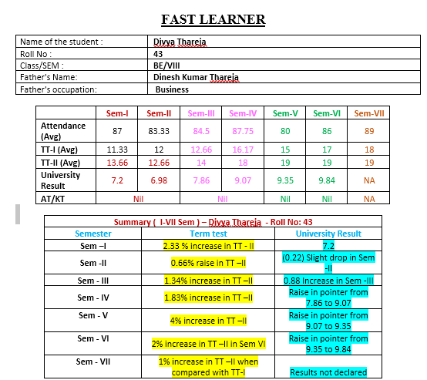
Student Mentoring Progression
Findings:
Gradual Improvement from FE – Sem – I to SE – Sem – VIII.
Exam scores is correlated to improvement in attendance of the student.
Initially student was not confident and not participated in any technical/extracurricular activities.
Rigorous Counselling is done focusing on the importance of Programming Languages, online Certifications viz. NPTEL, MOOCS etc., for Campus placement, Minor project implementation, active participation in academic activities and exam scores has significantly motivated the student to improve in all aspects

Slide 71
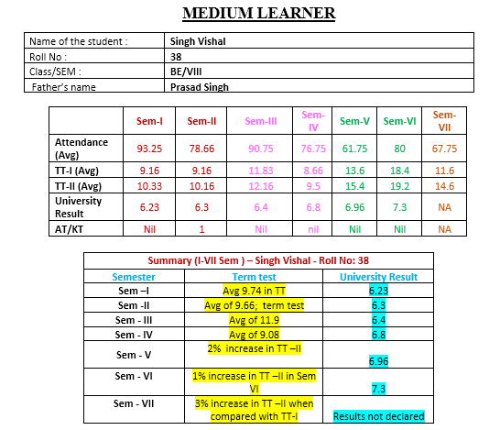
Student Mentoring Progression
Findings:
Average of 6.65 pointer is maintained from sem – I to Sem –VIII. There was a drop in attendance in Sem V.
Counselling is done for improvement in attendance, participation in co-curricular/extracurricular activities and improvement in academic results.
In sem VI, there is a raise of 19% in attendance average and which results in improvement of term test average from 14.5 to 18.8 in Sem V and Sem VI respectively.
Motivated students to participate in technical events and paper publication.

Slide 72
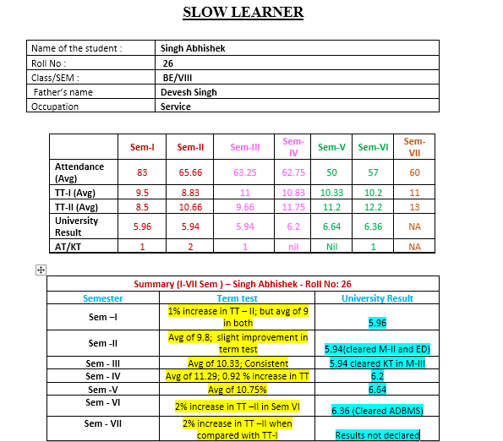
Student Mentoring Progression
Findings:
Average of 5.95 is maintained from Sem – I to Sem –VIII.
Attendance is very less during the semesters.
Interested in sports and participated in Intra level Competitions (basketball and volley ball).
Counselling is done for improvement in attendance and exam scores has significantly motivated the student to improve in both aspects.
S

Slide 73
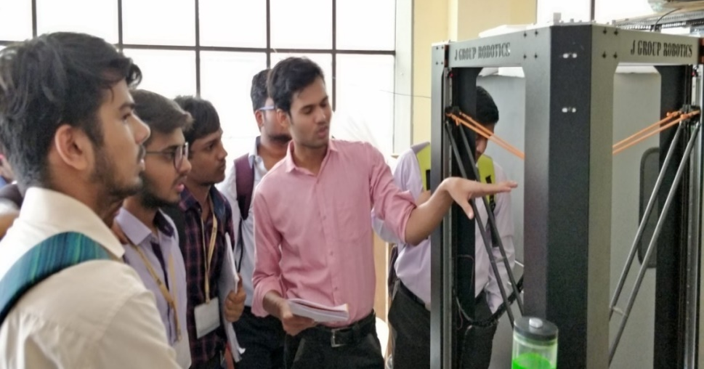
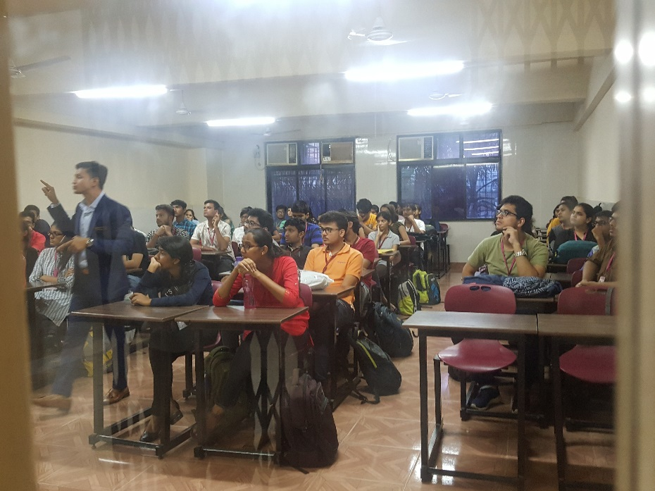
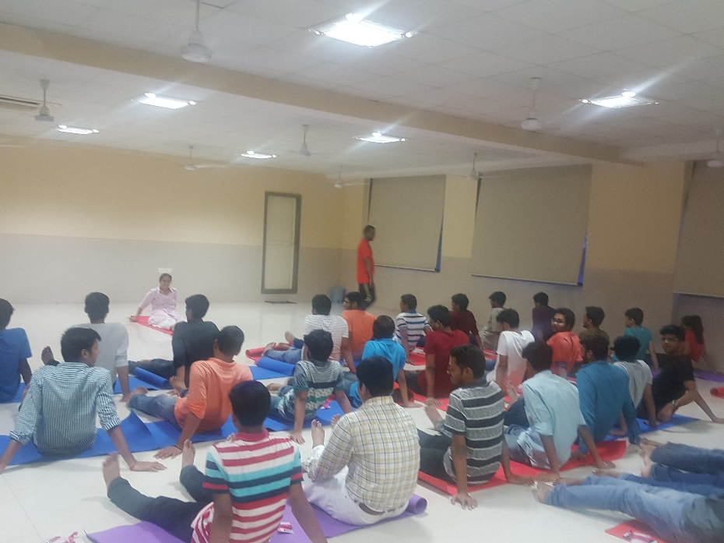
Glimpse of ACM Activities
Yoga Session
Industrial Visit
Seminar on higher education

Slide 74
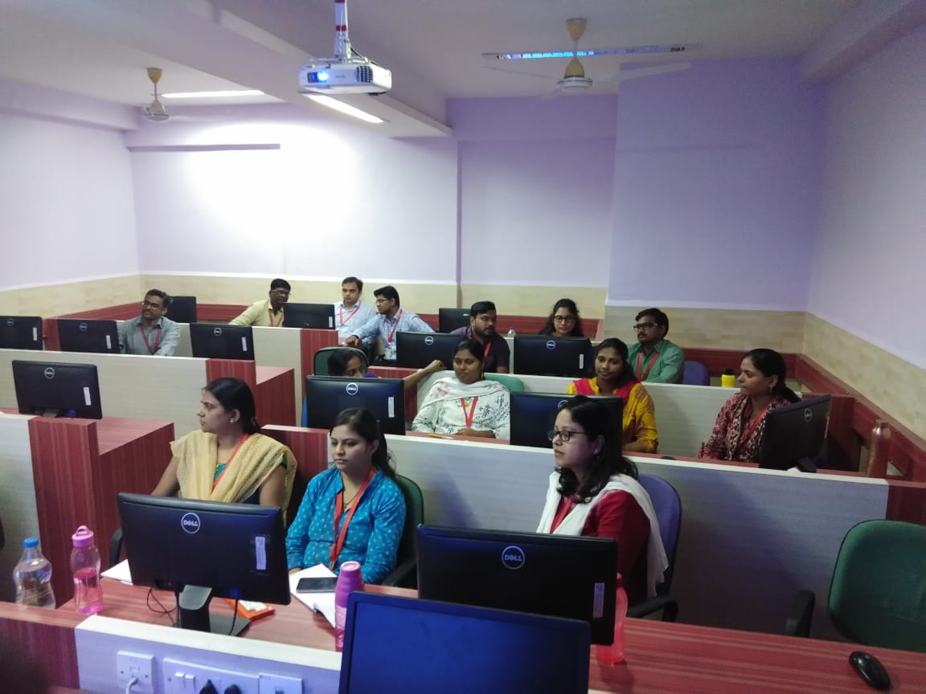
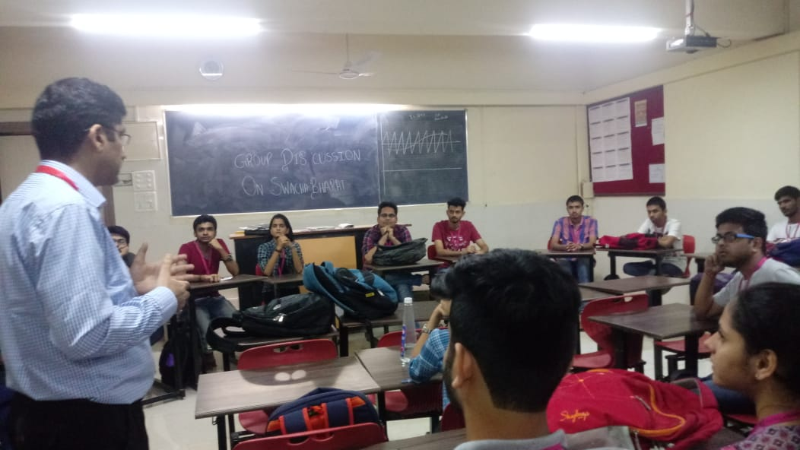
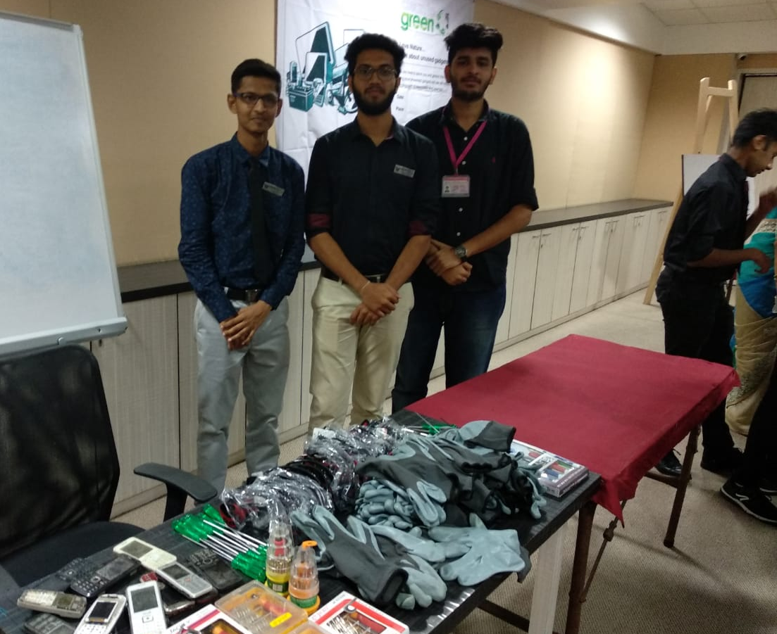
E-waste management
FDP on IoT
Group Discussion

Slide 75
ABL Activities
Institute
ACM
Student Core Committee Formation for AY 2018-19
Remedial work for monthly defaulter students for SE TE and BE
Hackathon Discussion and Team Formation
Case Study Presentation and Competition
Seminar on Higher Education
One Day Industrial Visit
Workshop on R programming
Remedial
Domain
E waste awareness
A Seminar on “SOLAR TECHNOLOGY ”
Seminar on “IPR awareness”
Seminar on “Matlab for engineers”
Domain Finalization for SE students
A Seminar on “Database Management”
Seminar on “Animation and Game Development”
A seminar on “Literature survey”
Case Study Presentation on topics like Unnat Bharat, Digital India etc
PPT Presentation on “Current Trends in E-Commerce”
Seminar on “Machine Learning”
Seminar on “Higher studies”
Hostel meet
Idea presentation
1,2,,6,10,11,12
1,2,3,4,5,6,7,9,10,11,12
1,2,3,4,6,10
1,2,3,4,6,10,11,12
PO’s attained

Slide 76
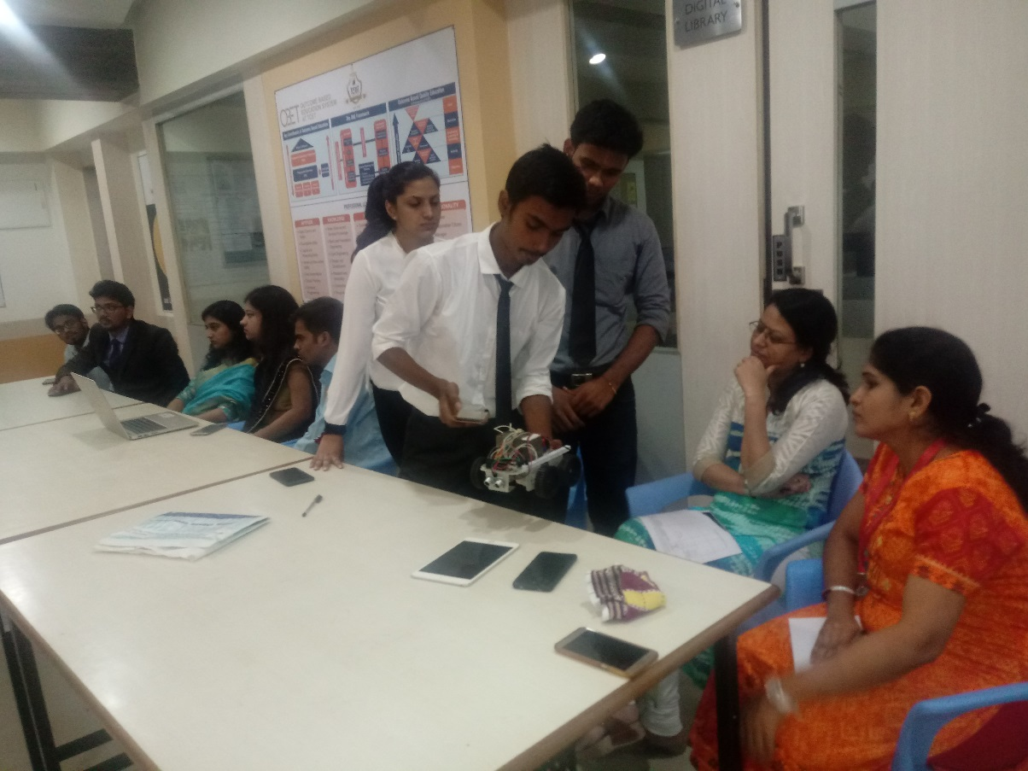
Institute Level Hackathon Competition
First Runner Up (Merit Of Excellence )

Slide 77
Male-Female Ratio of Last 3 Years
A.Y | 2016-17 |  |  | 2017-18 |  |  | 2018-19
Class | Male | Female | Total | Male | Female | Total | Male | Female | Total
SE | 112 | 41 | 153 | 116 | 40 | 156 | 109 | 36 | 145
TE | 113 | 43 | 156 | 115 | 38 | 153 | 111 | 40 | 151
BE | 102 | 50 | 152 | 113 | 41 | 154 | 116 | 38 | 154
Total | 327 | 134 | 461 | 344 | 119 | 463 | 336 | 114 | 450

Slide 78
FACULTY & DEPARTMENT CONTRIBUTIONS

Slide 79
Faculty Achievements & student Achievements
Faculty Achievements

Slide 80
Status of books procured at Dept. Library during last 3 years
Table AY 2016-17 onwards
Academic Year | Total Number of Books Ordered | Total Number of Books Currently Available
2016-17 | 62 | 531
2017-18 | 51 | 582
2018-19 | 33 | 615
Note: Since last accreditation visit , books procured in dept. library is 146

Slide 81
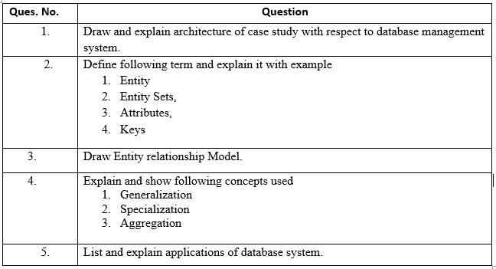
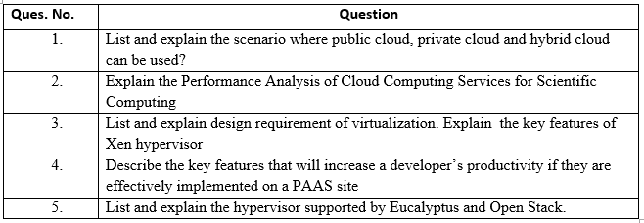
Process followed for improving quality of teaching learning
Instructions: Answer Q.1, Q.2, Q.3, Q.4 With respect to your selected application of case study (YouTube, Facebook, Online shopping, Zommato).
Design based assignments given to students which can map to real time examples

Slide 82
Process followed for improving quality of students projects
Application Based Project
Agile Methodology
Outcome will be product or prototype
Research Based Project
Waterfall Methodology
Outcome will be technical paper published in reputed journal
Project
Poster Making
Mapping with GA,PO, Subjects, curricular and extra curricular activities

Slide 83
Contribution to the Revision of UOM Syllabus (2016 Rev.)
Sr.No. | Name of Faculty member | Contribution for syllabus revision for Subject | Course/Semester | Syllabus Scheme
1 | Dr. Kamal Shah | Multimedia System | BE /SEM-VII | CBCGS
2 | Dr. Kamal Shah | Computer Graphics and Virtual Reality | TE /SEM – V | CBCGS
3 | Dr. Bijith M. | IT Strategy | ME -SEM I | CBCGS
4 | Dr. Bijith M. | Image Processing | ME -SEM I | CBCGS
5 | Dr. Bijith M. | IT Strategy | ME -SEM I | CBCGS
6 | Dr. Bijith M. | Image Processing | ME -SEM I | CBCGS
7 | Dr. Bijith M. | IT Enabled Services | TE SEM –V | CBCGS

Slide 84
Contribution to the Revision of UOM Syllabus
Sr.No. | Name of Faculty member | Contribution for syllabus revision for Subject | Course/ Semester | Syllabus Scheme
8 | Dr. Bijith M. | Green IT | TE / SEM –VI | CBCGS
9 | Dr. Bijith M. | Enterprise Resource Planning | BE / SEM - VIII | CBCGS
10 | Dr. Rajesh Bansode | Wireless Ad-Hoc Sensor Network | ME / SEM-II | CBCGS
11 | Dr. Rajesh Bansode | Wireless Technology | BE/SEM-VII | CBCGS
12 | Dr. Rajesh Bansode | Multimedia Systems | BE/SEM- VII | CBCGS
13 | Dr. Rajesh Bansode | Security and Risk Management | ME/SEM-II | CBCGS
14 | Dr. Rajesh Bansode | Ethical Hacking and Foreigncis | ME/SEM-II | CBCGS
15 | Mr. Bhushan Nemade | Python Programming | SE/ SEM- IV | CBCGS
16 | Mr. Bhushan Nemade | Java Programming | SE/ SEM- III | CBCGS

Slide 85
Contribution to the Revision of UOM Syllabus
Sr.No. | Name of Faculty member | Contribution for syllabus revision for Subject | Course/ Semester | Syllabus Scheme
17 | Dr. Rajesh Bansode | Logic Design | SE/SEM-III | CBCGS
18 | Dr. Rajesh Bansode | Computer Organization and Architecture | SE/SEM-IV | CBCGS
19 | Dr. Rajesh Bansode | Principal of Communications | SE/SEM-III | CBCGS
20 | Dr. Rajesh Bansode | Digital Design Lab | SE/SEM-III | CBCGS
21 | Dr. Rajesh Bansode | Microprocessor Programming Lab | SE/SEM-IV | CBCGS
22 | Dr. Rajesh Bansode | Microcontroller and Embedded Programming | TE/SEM-V | CBCGS
23 | Dr. Rajesh Bansode | IOT Lab | TE/SEM-V | CBCGS

Slide 86
Contribution to the Revision of UOM Syllabus

Slide 87
Innovative and Best Practices
Best Practices
Innovative Practices
Stakeholder Engagement through Advisory Committee, Parents and Program Assessment Committee(PAC) meetings for Dissemination of Information to stakeholders, Inputs from industry , Guidance for academic conduct, Strategic planning for achieving MVS.
Orientation(SOP) and foundation program(FP) at the start of each semester for effective academic conduct.
Project based learning and skill development to promote students' engagement through deep learning concerned to technical projects, internships with startups and consultancy.
Mentorship (TG) and student portfolio building is carried out to check students’ progress which is monitored for improvement in regard to academics, placements, higher studies and lifelong learning.
Video recording of lectures and practical's of all faculty members for effective academic conduct.
Lesson plan and Practical plan ,Bridge Course , Mini, Minor, Major Project Uploaded on website(LRC) for Dissemination of information to stakeholders regarding Teaching learning process.
HOD/Dy.HOD accompanying industrial visit for better monitoring, control, discipline, care and protection of students.
E-magazine to improve technical and non-technical aspects among stakeholder.
Motivate students for skill development to increase students publication in project competition, internship and startups
Faculty Development program for the domain strengthening of all faculty members
Faculty action plan with compliance for better improvement in faculty performance.
Design & delivery of industry relevant courses viz. Blockchain Technology
Application of education technology like Think pair share technique, Google classroom, Quiz, Doubt clearing sessions for slow learners.
Students & faculty members brainstorm real life problems during assignment sessions
Design methodology to emulate real life situations for Lab sessions.

Slide 88
Department Targets & Goals
Strengthening of domains
Faculty & Students Empowerment (industry requirements)
Consultancy, industry internships
& Collaborations
Notes:
© Copyright PresentationGo.com – The free PowerPoint template library

Slide 89
Thank you

